Slide 1
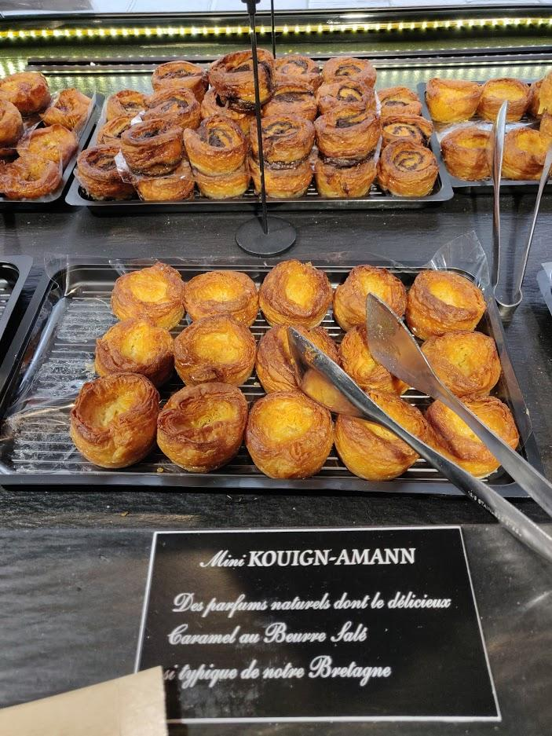

Opening a Bakery near Boston, Massachusetts
By Stephane D.

Slide 2
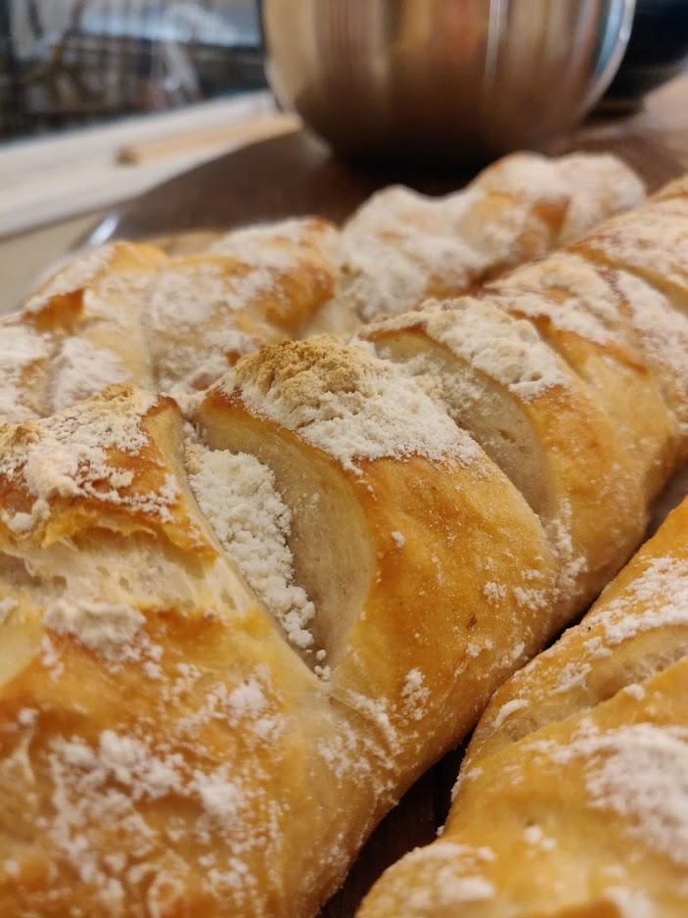

Introduction
One of my dream business opportunities would be to open a bakery (I’m French).
I live in the Cambridge/ Somerville area (right across the river from Boston, Massachusetts) and these neighborhoods have experienced an increase in appeal over the last ten years.

Slide 3
Purpose: To find the perfect location for opening a bakery
Criteria
Proximity to existing bakeries (yet not too close to avoid direct competition)
Within distance to public transport
Located in an up-and-coming neighborhood
Data Used with Respect to Criteria
Foursquare API to locate current bakeries in the area
Geocoder for subway stations
City of Cambridge data to determine attractiveness of the neighborhood

Slide 4
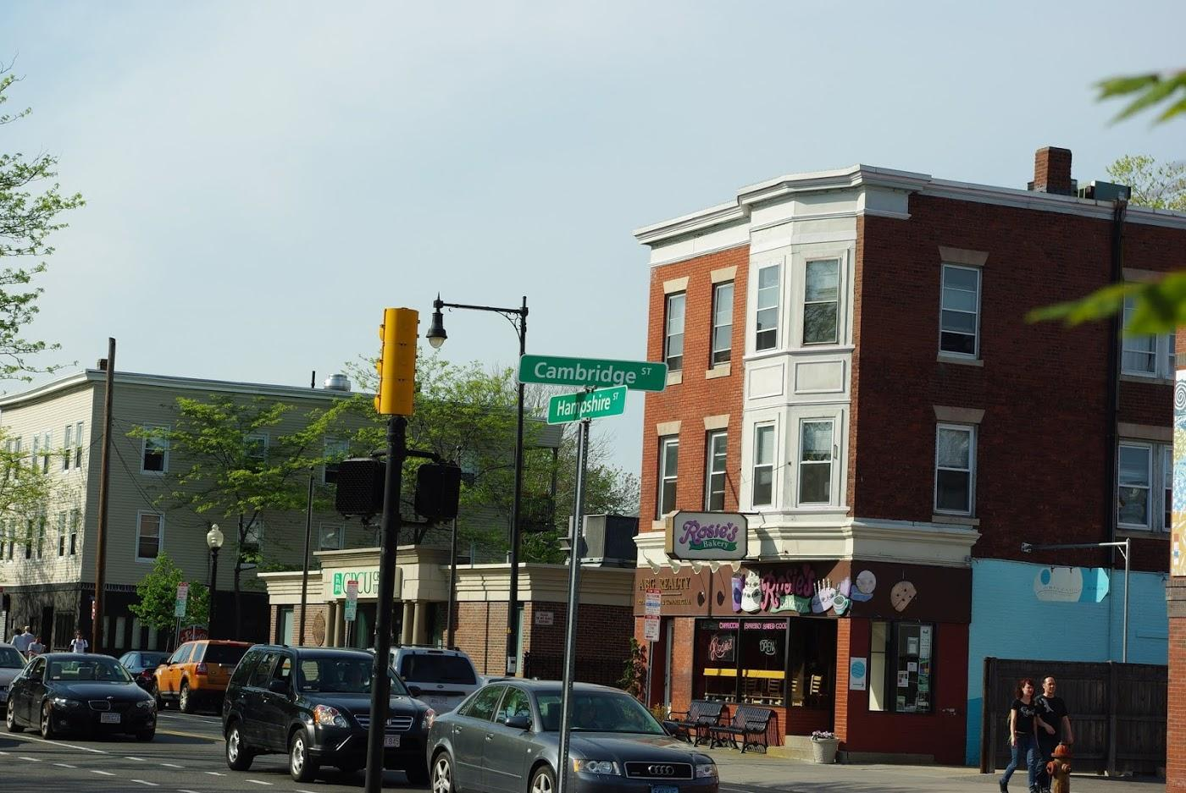
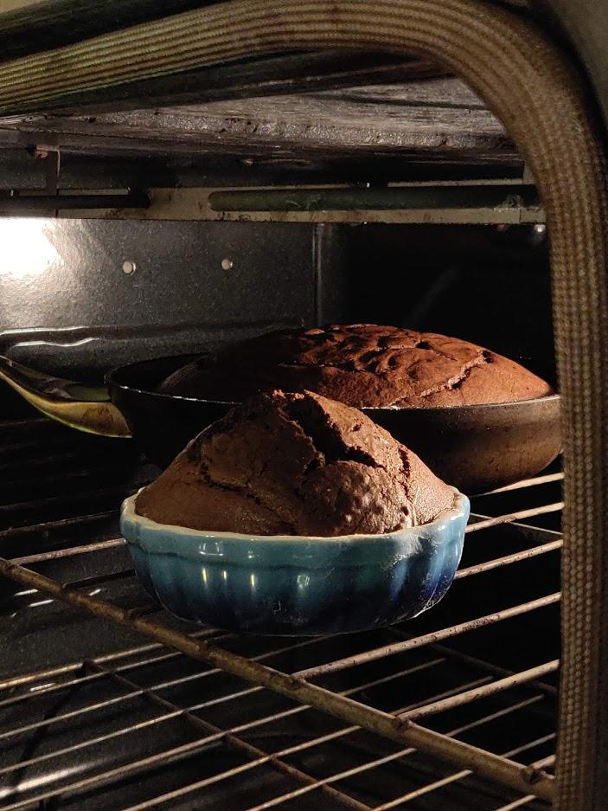
Methodology
Using the Folium package, the data will be displayed using markers with a specific radius.
The radii will be obtained using trial and error until real-life results are obtained.

Slide 5
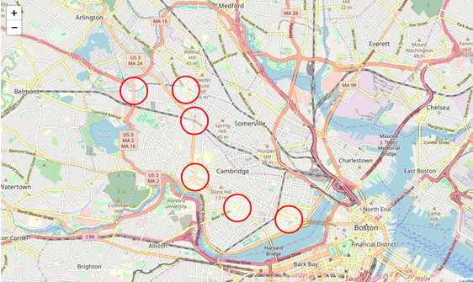
Criterium #1: Public Transit
A radius of 400 meters was deemed appropriate (subway stations are quite spread out in Boston compared to other major cities).
This is the radius inside which it would be optimum to install a new business.

Slide 6
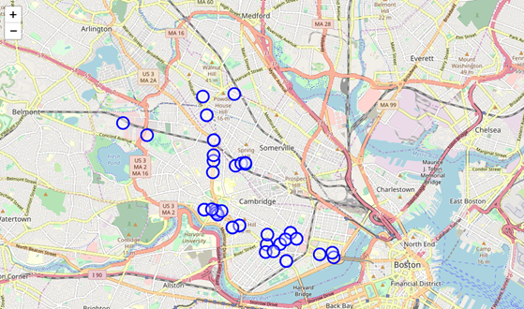
Criterium #2: Existing Bakeries
Using the Foursquare API, the “venue search” commands are issues for bakeries using the ‘categoryID’ for bakeries (this turned out to be more accurate than just searching for ‘bakery’).
A radius of 150 meters was deemed appropriate around a bakery. This is the radius inside which we should NOT open any new bakery business because it’s too close to an existing one.

Slide 7
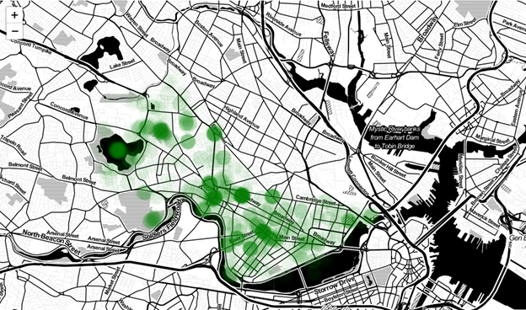
Criterium #3: Attractiveness of the Neighborhood
I wanted to obtain data about real estate prices in the area but after hours of searches, all I could find was the 2012 property tax data of the City of Cambridge, which had a lot of missing data, including the square footage of most units.
I decided to go another route and display the “attractiveness” of neighborhood (https://data.cambridgema.gov/Planning/Envision-Cambridge-Mobile-Engagement-Feedback/sx7w-cut7/data).
After importing the data, I have drawn lightly shaded circles to display every positive comment about the city at the recorded location.

Slide 8
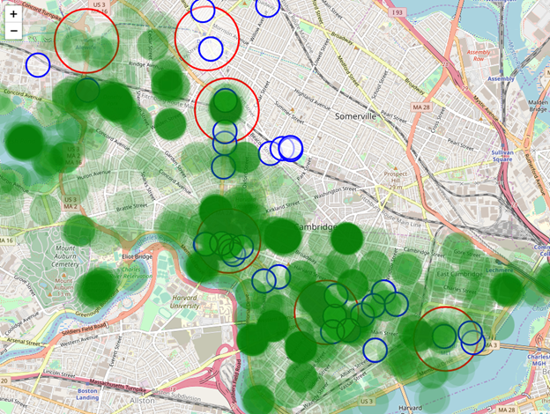
Three Criteria Combined

Slide 9
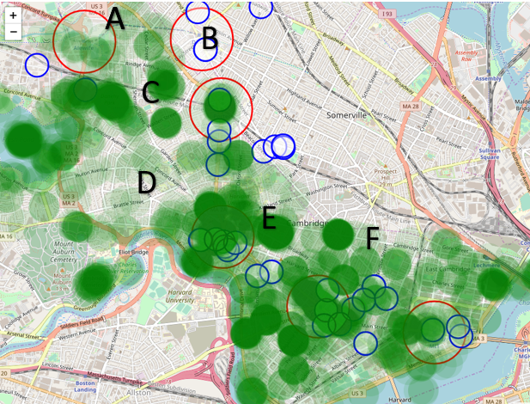
Area A
No existing bakeries
In vicinity of the subway
Attractiveness of the area is low

Slide 10
Area B
Two existing bakeries (could be a positive or a negative)
Near the subway
No data for attractiveness (it’s technically a different town)

Slide 11
Area C
Far away from existing bakeries
Near the subway
Considered to be an “attractive” area of Cambridge

Slide 12
Areas D, E, and F
Popular locations
Near public transit
Many existing bakeries, and therefore, lots of competition
Area F would be the best choice within this stretch of Cambridge.

Slide 13
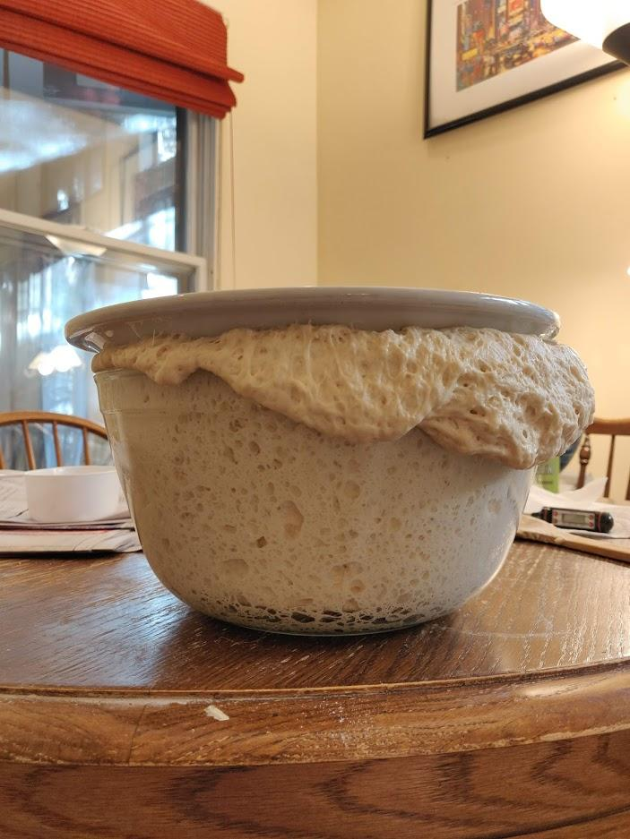
Discussion
Two caveats to this analysis:
It would make sense to see what business spaces are for lease first, and then cross-check the map to see if the location meets the other criteria.
This analysis only considers a few parameters, but many others are at play:
Proximity to bus lines
Wealth of the neighborhood
Safety of the neighborhood
Foot traffic at that location
Cost of retail space
And many more!

Slide 14
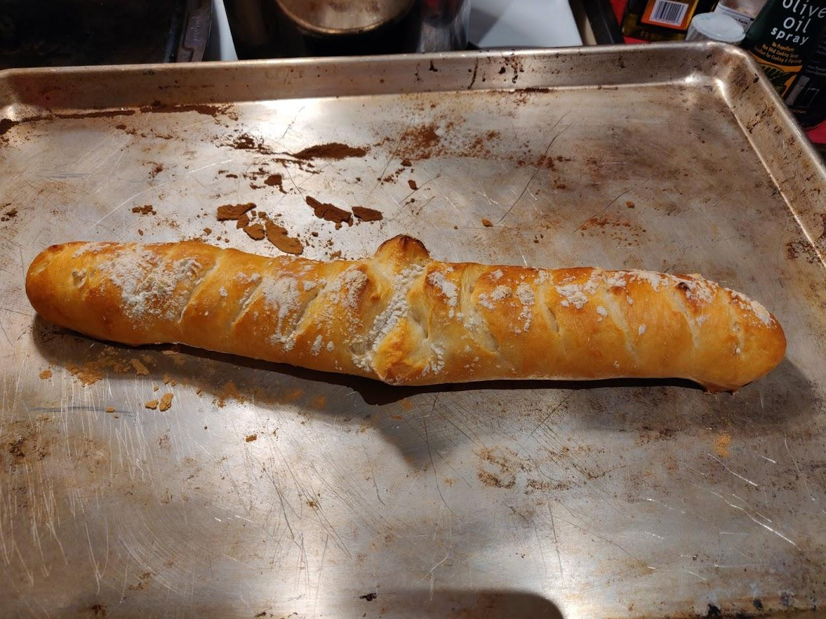
Conclusion
Report presents a simplified analysis of a Boston neighborhood and the potential location for opening a new bakery
Report mixes the data from various sources to attempt to judge of the quality of a specific address
Great starting point for someone actively looking to open a business in an up-and-coming area of a growing city

Slide 15
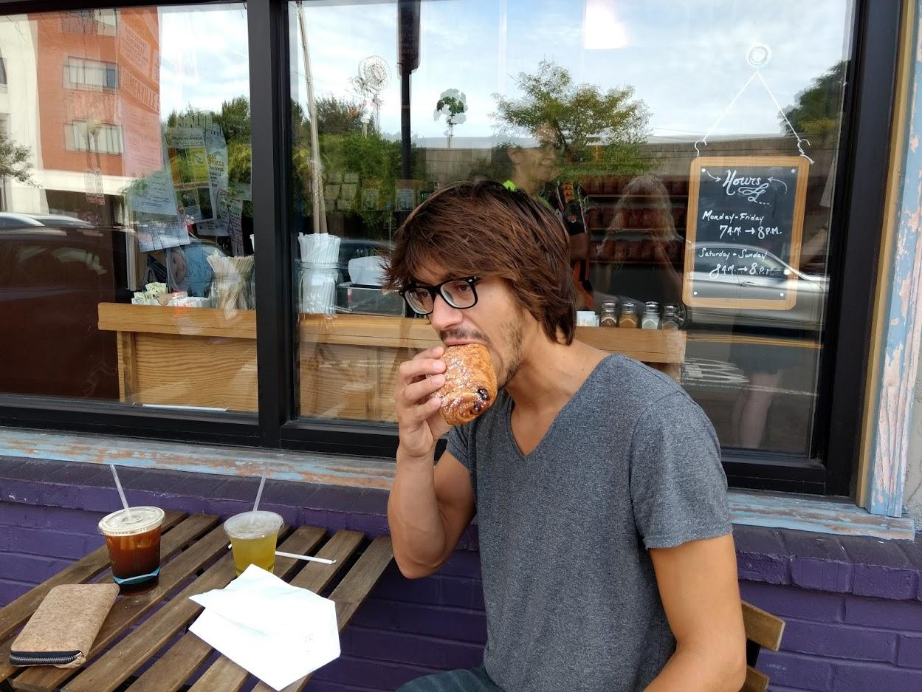
merci!!!!

